Slide 1
Local Value Numbering & SSA
CSIE 5054: Advanced Compiler Design
Instructor: Shih-Wei Liao

Slide 2
Table of Contents
Local Value Numbering (LVN)
Local Optimizations
Value Numbering
Summary
Static Single-Assignment Form (SSA)
Building SSA
Homework 4
SSA construction for Bril

Slide 3
Local Optimizations
Dead Code Elimination (DCE)
@main {
a: int = const 1;
a: int = const 2;
print a;
}
@main {
a: int = const 2;
print a;
}

Slide 4
Local Optimizations
Copy Propagation
@main {
x: int = const 4;
copy1: int = id x;
copy2: int = id copy1;
print copy2;
}
@main {
x: int = const 4;
print x;
}
Notes:
Whether to eliminate dead code or not in Copy Propagation, Constant Folding, and CSE depends on implementation.

Slide 5
Local Optimizations
Constant Folding
@main {
a: int = const 1;
b: int = const 2;
sum: int = add a b;
print sum;
}
@main {
sum: int = const 3;
print sum;
}

Slide 6
Local Optimizations
Common Subexpression Elimination (CSE)
@main {
a: int = const 4;
b: int = const 3;
two: int = const 2;
t1: int = mul a two;
t2: int = mul a two;
t3: int = mul t2 b;
result: int = add t1 t3;
print result;
}
@main {
a: int = const 4;
b: int = const 3;
two: int = const 2;
t1: int = mul a two;
t2: int = mul t1 b;
result: int = add t1 t2;
print result;
}
Notes:
This CSE example includes elimination. The renaming t3 to t2 is not needed, but a good implementation to introduce the register space

Slide 7
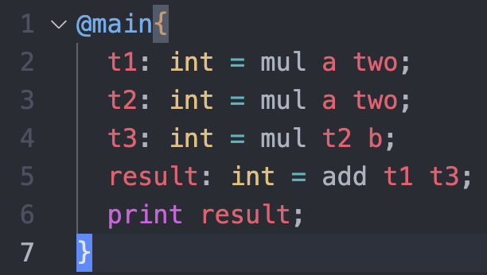
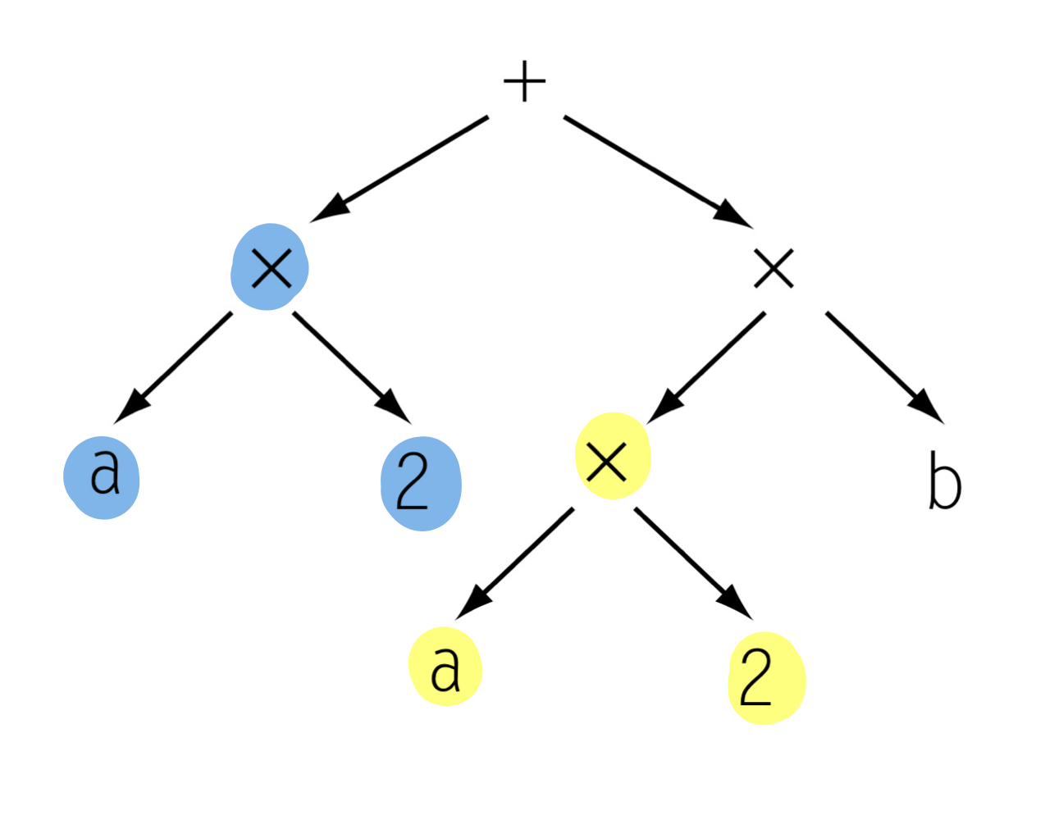
Common Subexpression Elimination

Slide 8
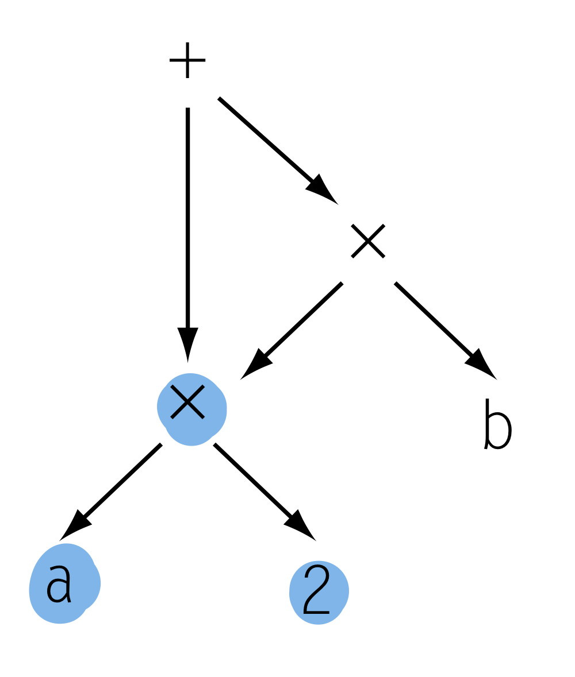
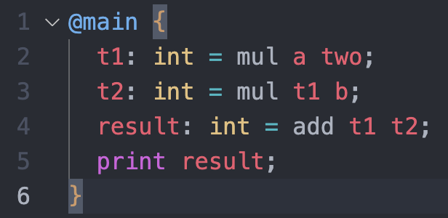
Common Subexpression Elimination

Slide 9
Common Subexpression Elimination

Slide 10
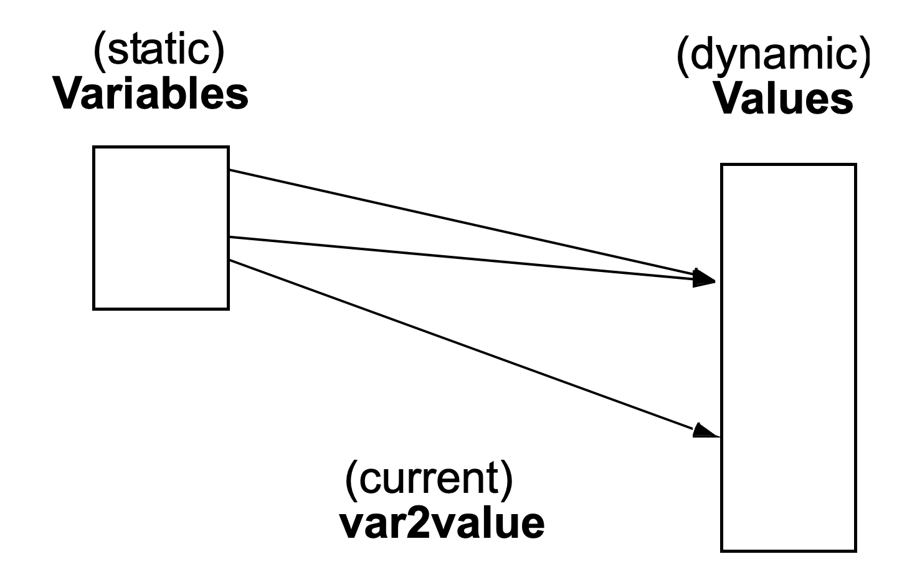
Value Numbering: Another Abstraction
Compared to DAG, more explicit with respect to values and times.
Each value has its own “number”.
Common subexpression means the same number.
var2value: current map of variable to value.
used to determine the value number of current expression.
v1 + v2 = var2value(r1) + var2value(r2)

Slide 11
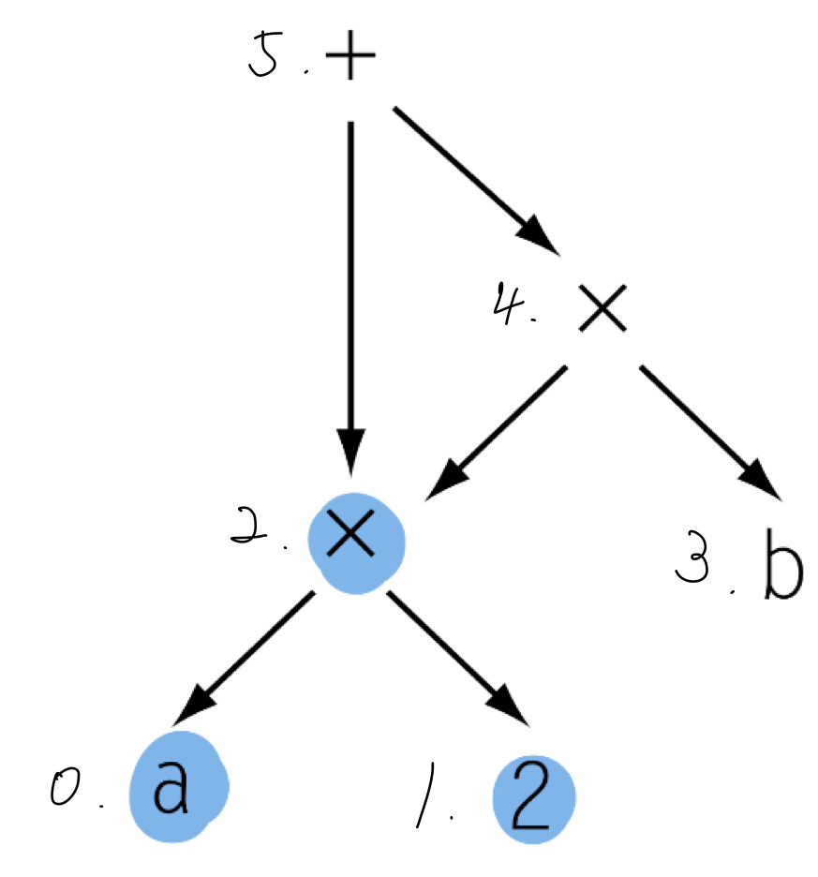
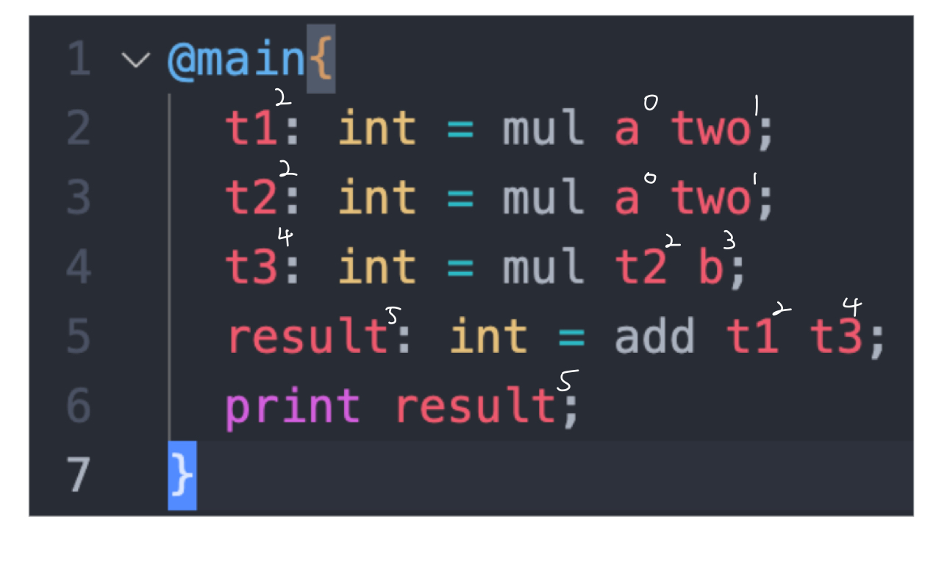
Value Numbering: Example
Notes:
The superscript of a variable is its value number.

Slide 12
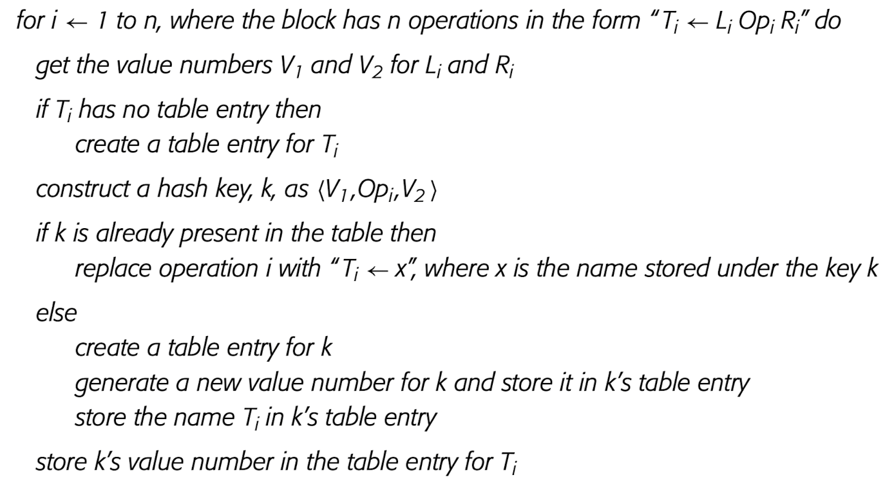
Value Numbering Algorithm
for-do the symbolic execution: Case “then”: I.e., lookup found!
Value as number | Value as expression (hashkey k) | Var as name (a.k.a. canonical name or compile-time name)
1 | k: {V1}{OPi}{V2} | x
for-do the symbolic execution: Case “else”: I.e., create the entry for k:
Value as number | Value as expression (hashkey) | Var as name (a.k.a. canonical name)
1 | k: {V1}{OPi}{V2} | T_{i}
Notes:
// E.g., k can be a textual string “{V1}{OPi}{V2}”.

Slide 13
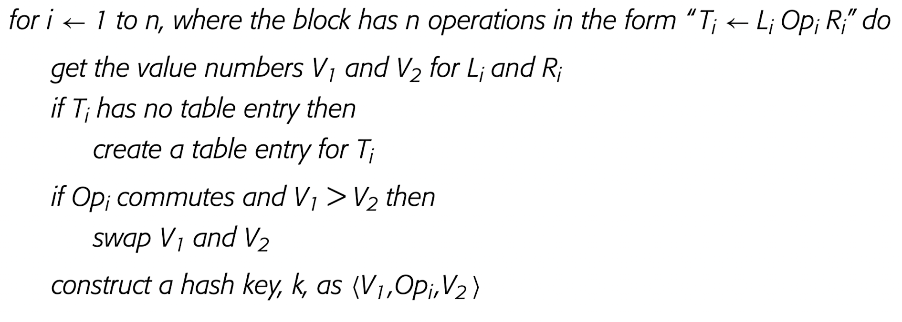
Extending the Value Numbering Algorithm
Commutative Operations
Variants of a commutative expression, such as a × b and b × a, should receive the same value number.
We can sort the operands to ensure the expressions receive the same value number.
…

Slide 14
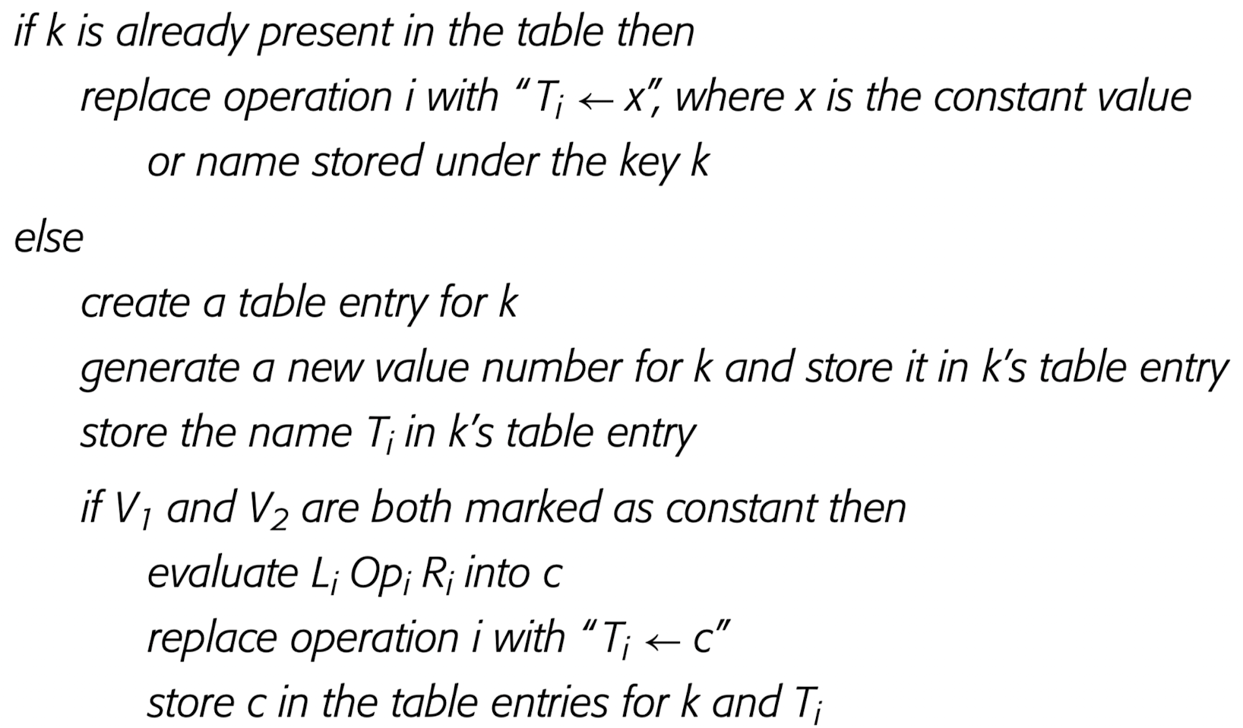
Extending the Value Numbering Algorithm
Constant Folding
Marks hash table entry as constant, and store the constant value alongside the value number.
Evaluates constant expression, and replace it with a constant value.
Notes:
Note that the pseudo code is expended from … last page.

Slide 15
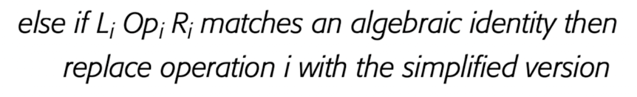
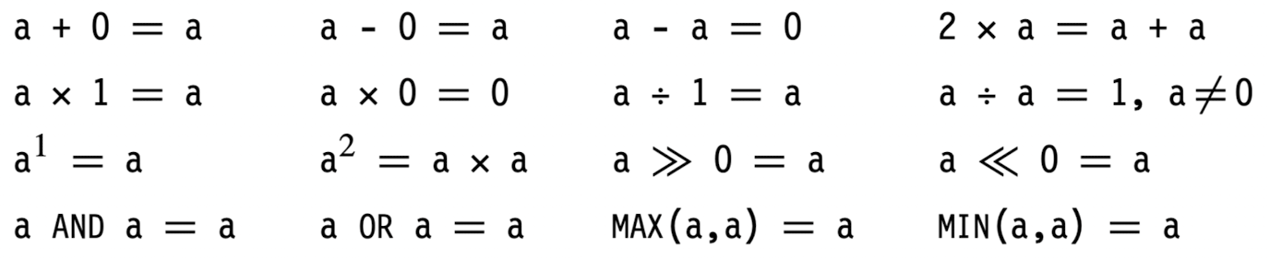
Extending the Value Numbering Algorithm
Algebraic Identities
Simplifies the expressions with variables. For example, x + 0 and x should receive the same value number.
Test per identity would significantly slow down LVN.
LVN should organize the tests into operator-specific decision trees.
Figure. The Algebraic Identites with Simplefied Versions
Notes:
Continued the pseudo code from last page.
operator-specific decision trees : a bunch of if-else for each operator

Slide 16
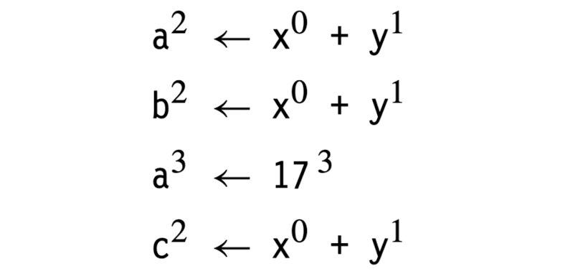
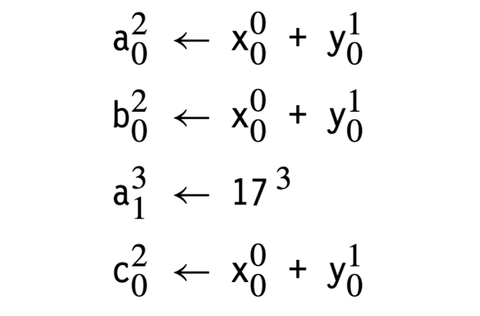
The Role of Naming
The variable naming can limit the effectiveness of LVN.
Consider applying LVN to the two examples below:
On the left: At the fourth operation, c <- x + y cannot be rewritten to c <- a since a no longer holds value number 2 after the third operation.
On the right: Each operation defines a unique name and thus the desired result.
Notes:
On the left, we need extra effort to track the var2value, which clutters up the basic algorithm of LVN w/ extension, and the result is not desired. The subscript is the instance of variable write. For example, a₀ is the first write since 0-indexed; a₁ is the the second write.

Slide 17
Summary of LVN
Value Numbering Algorithm finds the redundant expressions of CSE and copy propagation within a basic block, and replace them.
The Extended Value Numbering Algorithm deals with commutative operations, constant folding, and algebraic identities.
Even with above extension, LVN does not tackle elimination.
To eliminate dead code, we can tweek LVN with more extension for a specific IR.
Or iteratively run LVN and DCE to eliminate the dead code produced from LVN.
To address the naming problem, the simple solution is to apply LVN to the code in Single Static-Assignment form.
Notes:
Even the example does not tackle elimation, but it address the naming problem.

Slide 18
End of Part I. of the Lecture

Slide 19
Table of Contents
Local Value Numbering (LVN)
Local Optimizations
Value Numbering
Summary
Static Single-Assignment Form (SSA)
Building SSA
Homework 4
SSA construction for Bril

Slide 20
Single Static-Assignment Form (SSA)
a ← …
a ← …
a0 ← …
a1 ← …
← a x b
a2 ← 𝜙(a0,a1)
← a2 x b0
Original Code
Code in SSA Form

Slide 21
Single Static-Assignment Form
Rules
Each assignment in the procedure defines a unique name
any expression is available at any point after being evaluated
Each use in the procedure refers to a single name
a use can be written with a single name rather than a long list of all the definitions that might reach it
𝜙-function
merge definitions along multiple control paths into a single one

Slide 22
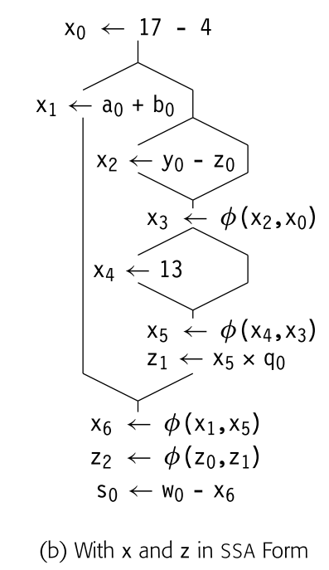
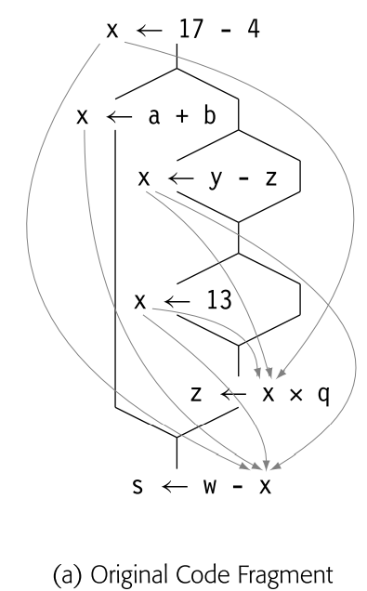
Single Static-Assignment Form - example
LHS
The curved gray lines show which definitions can reach each use of x
RHS
Variables have been renamed with subscripts to ensure unique names for each definition

Slide 23
Building SSA
Dominance Frontier
Insert 𝜙-function
Renaming

Slide 24
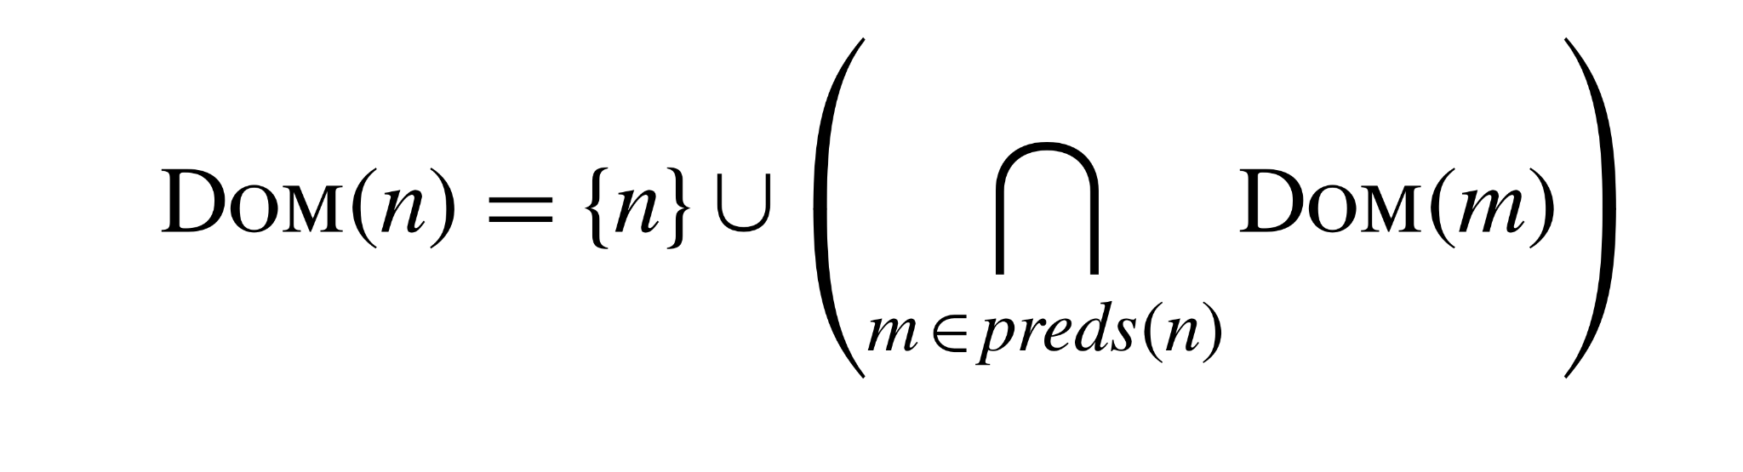
Dominance Frontier
Recap: Dominance
Def. In a CFG with entry block b0, block bi dominates block bj iff bi lies on every path from b0 to bj
A block bi dominates another block bj iff block bi dominates all of the predecessors of block bj
DOM(n): The set of blocks that dominate block n

Slide 25
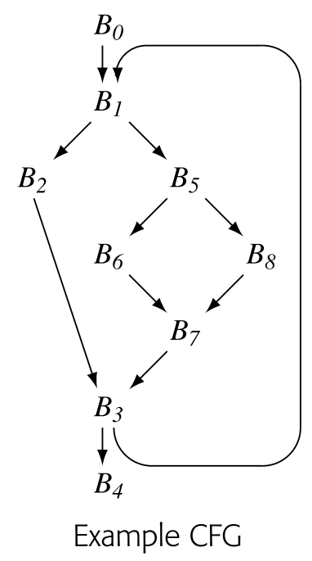
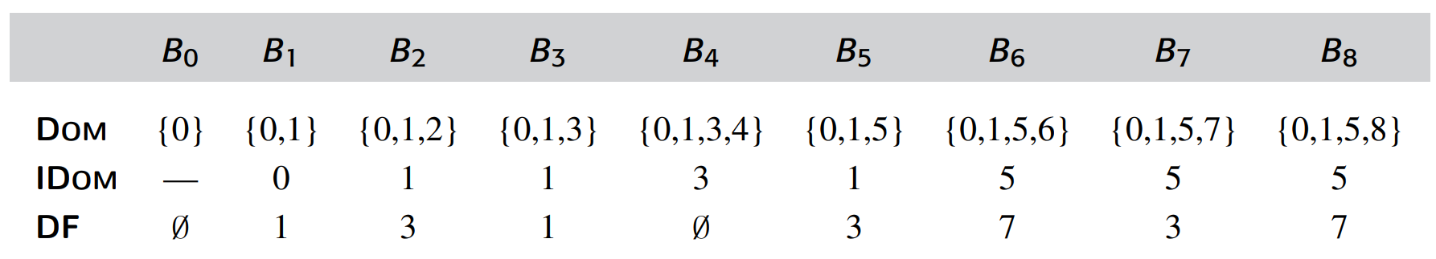
Dominance Frontier
Immediate Dominator
Def. In a CFG, one block m ∈ DOM(n), m ≠ n, will be closer(has the shortest path length) to n than any other block x ∈ DOM(n), x ≠ n
IDOM(n): The immediate dominator of n
Notes:
Take B5 as example

Slide 26
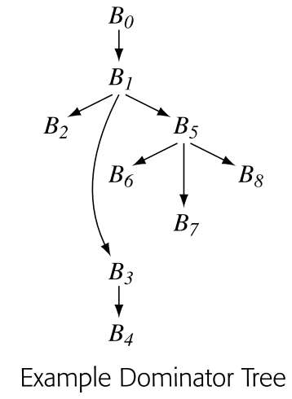
Dominator Tree
A tree encodes the dominance info. for a CFG
Node
Each node in the CFG
Edge
Immediate dominance
For a block n, DOM(n) contains precisely the blocks on the path from n to the root of the dominator tree
Notes:
Take B3 as example

Slide 27
Dominance Frontier
A block q ∈ DF(p) if, along some path, q is one edge beyond the region that p dominates.
To be more precise
q has a CFG predecessor that p dominates. There exists an x such that (x, q) is a CFG edge and p ∈ DOM(x)
p does not strictly dominate q. That is, p ∉ (DOM(q) − q)
DF(p): The set of blocks that meet the two criteria

Slide 28
Dominance Frontier
A definition of variable, say x, in block n forces the insertion of a 𝜙-function for x at the head of each block m ∈ DF(n)
Notes:
Take B1, B5 for example

Slide 29
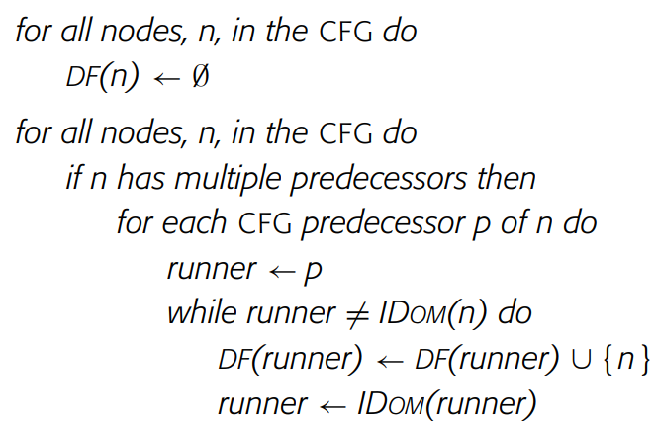
Dominance Frontier-algorithm
Algorithm to build dominance frontier
Notes:
Take B3 as example
If p = IDOM(n), then n does not belong to DF(p). Neither does it belong to DF(m) for any predecessor m of p.
If p =/= IDOM(n), then n belongs in DF(p). It also belongs in DF(q) for any q such that q ∈ DOM(p) and q ∈/ (DOM(n) − n). The algorithm finds these latter nodes q by running up the dominator tree

Slide 30
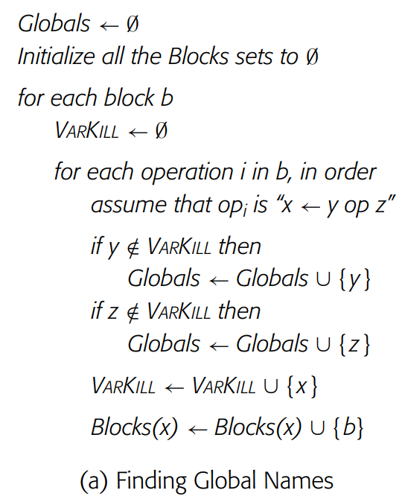
Insert 𝜙-function - algorithm1
Global Names
Variables that are of interest in multiple blocks
Variables in algorithm
Globals
a set of global names
Blocks(x)
a set of blocks contain a definition of x
VARKILL
a set of variables that are defined in block m
Notes:
Why global names?
A name x cannot need a φ-function unless it is live in multiple blocks.

Slide 31
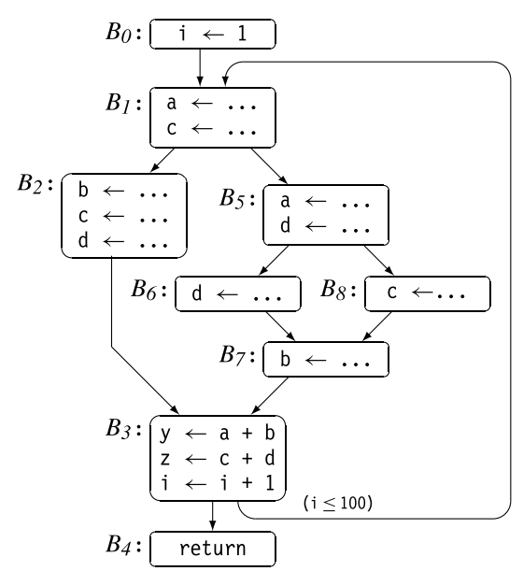
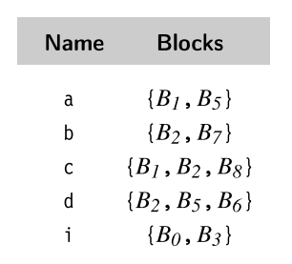
Insert 𝜙-function
Blocks set of y and z are omitted since they’re Not global names
Notes:
Take a and c for example

Slide 32
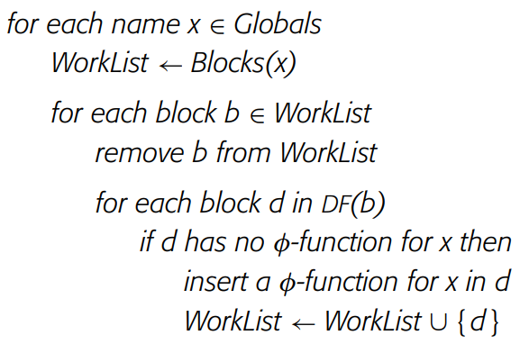

Insert 𝜙-function- algorithm2
Notes:
Run a as example

Slide 33
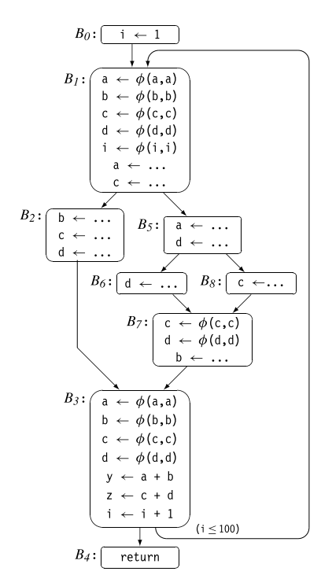
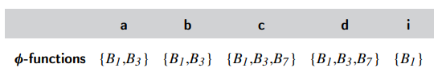
Insert 𝜙-function
Notes:
Take “a” as example

Slide 34
Renaming
In the final SSA form, each global name becomes a base name
Individual definitions of that base name are distinguished by a numerical subscript
Example:
base name, say a
the first definition of a that the renaming algorithm encounters will be named a0

Slide 35
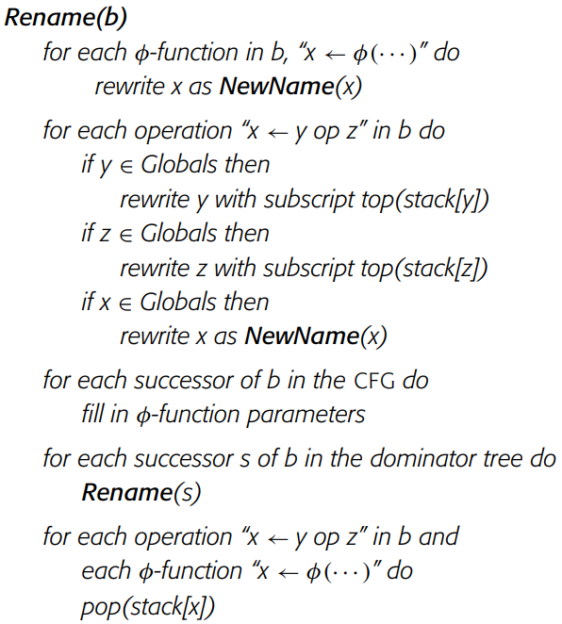
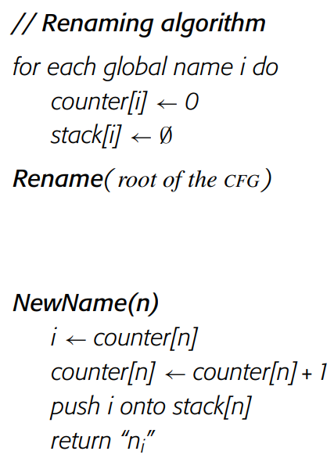
Renaming - algorithm
issues?
Notes:
Remind the students of the case: x is assigned multiple times in a block, and x is a NOT global name. x still needs renaming

Slide 36
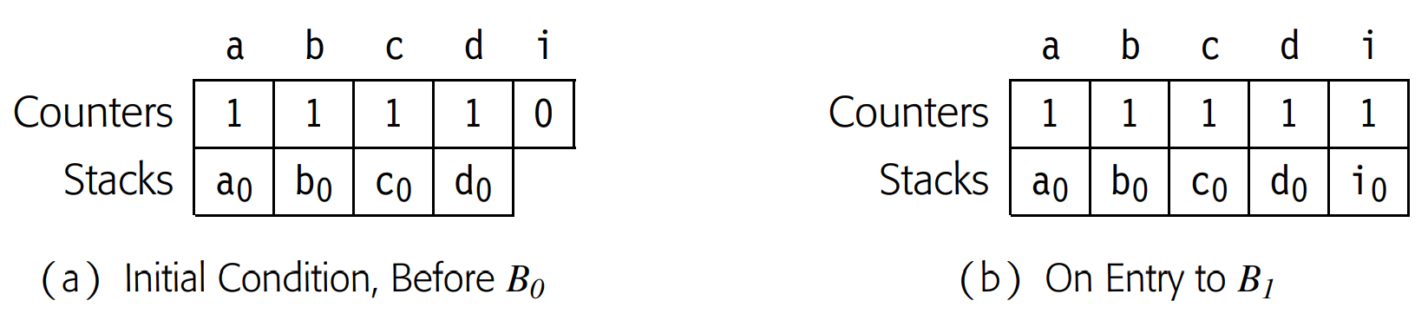
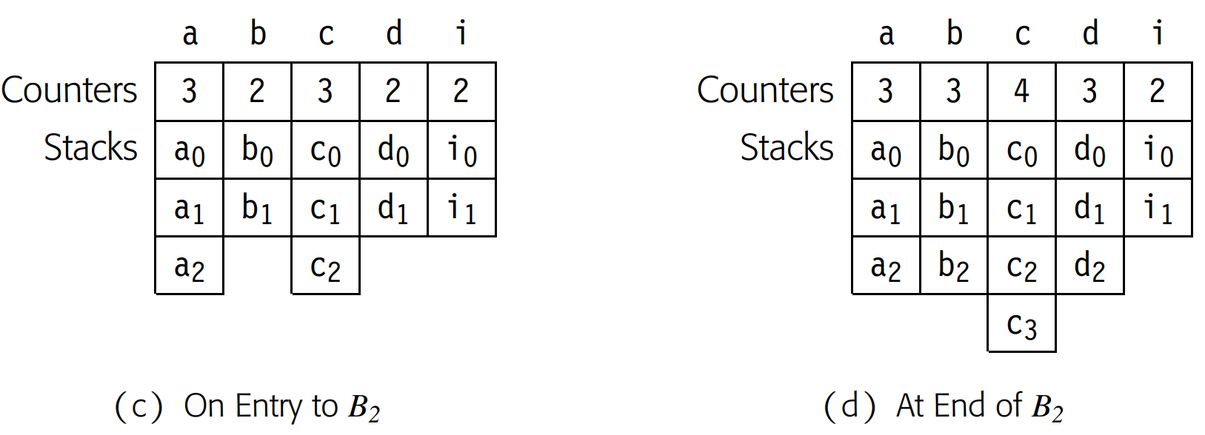
Renaming - example

Slide 37
Renaming - example

Slide 38
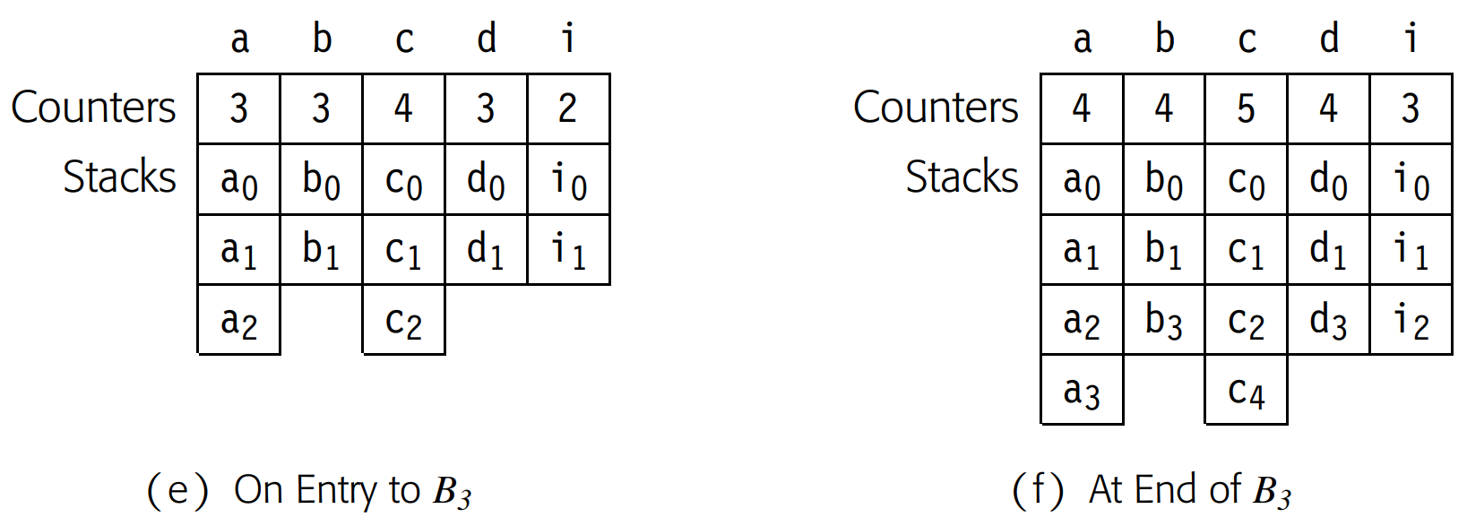
Renaming - example

Slide 39
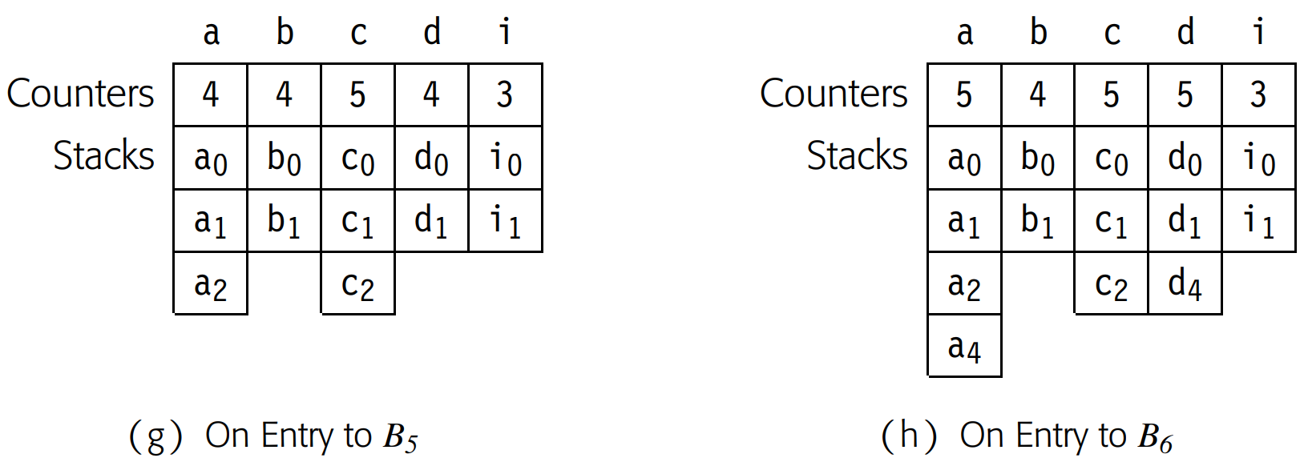
Renaming - example

Slide 40
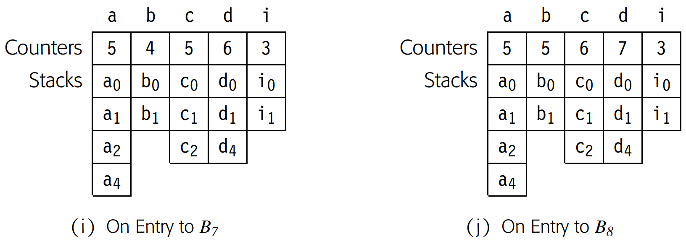
Renaming - example

Slide 41
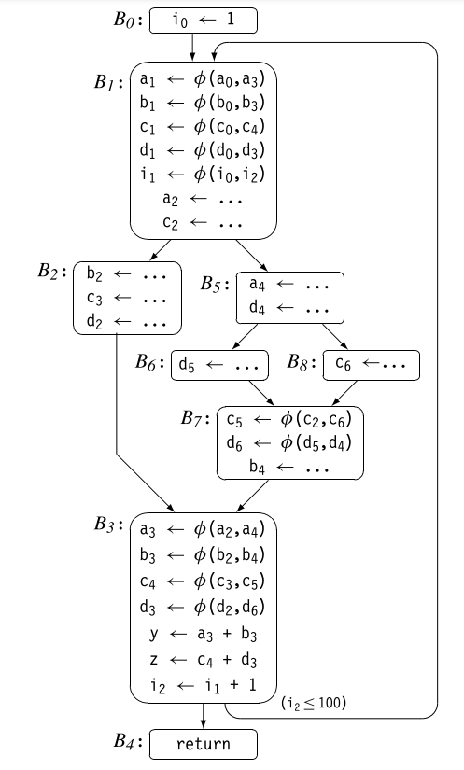
Renaming - example

Slide 42
Homework 4: SSA Construction for Bril
Deadline: 2025/11/7 23:59
Homework 2 Specification
Homework 2 Github Repo

Slide 43
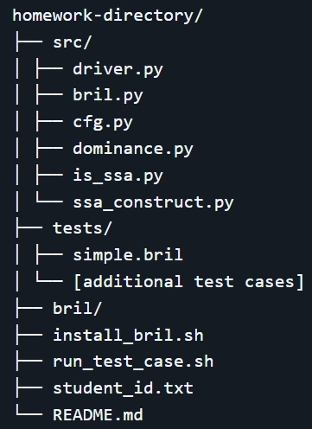
Homework 4: SSA Construction for Bril
Goal: transform a given non-SSA Bril program into its SSA form
Set up environment
Bril toolchain(HW0)
Python3.7+
Implementation Tasks
CFG Construction (cfg.py)
Dominator Computation (dominace.py)
𝜙-function Insertion (ssa_construct.py)
Variable Renaming (ssa_construct.py)
Validation

Slide 44
DOs and DONTs
Make sure a thorough understanding of the algorithm before starting
Ensure your Student_ID are correctly entered in student_id.txt
Within /src directory
Feel free to modify any files except for is_ssa.py
Do NOT modify anything except for the above-mentioned files. Any such changes will be considered cheating.

Slide 45
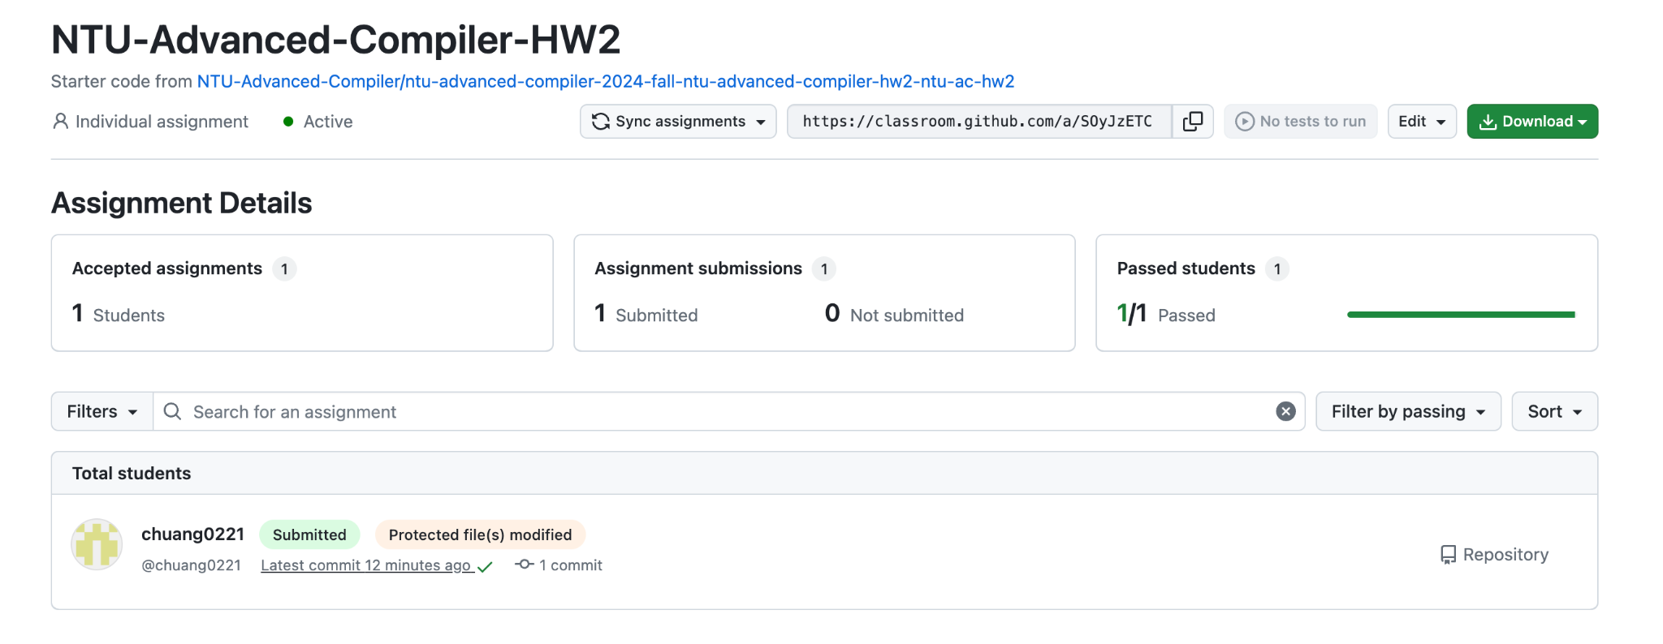
DOs and DONTs
Please note that we will be able to see through the GitHub Classroom backend if you have made changes to files that should not be modified.

Slide 46
DOs and DONTs
Please stay away from idiotic plagiarism.
AI instead of TA will provide individual debugging support for coding.
Professor can do the class-level debug support.
If you have any questions relating to the homework, please email to llvm@csie.ntu.edu.tw with the subject line '[AC-HW2][Summary of Your Issue]'

